Slide 1

EVALUATING CLASSIFICATION PROBLEMS
USING
PERFORMANCE METRICS
SEMINAR
UTPAL MISHRA

Slide 2
01
INTRODUCTION
02
EVALUATION METRICS
CONTENTS
03
CONCLUSION
04
REFERENCES

Slide 3
INTRODUCTION
The idea of building machine learning models works on a constructive feedback principle. The model build gets the feedback from metrics, makes improvements and continue until you achieve a desirable accuracy.
Evaluation metrics explain the performance of a model. An important aspect of evaluation metrics is their capability to discriminate among model results.
one

Slide 4
EVALUATION METRICS
Evaluating a model is a core part of building an effective machine learning model. Different evaluation metrics are used for different kinds of problems
two

Slide 5
EVALUATION METRICS
TYPES
When we talk about predictive models, we are talking either about a regression model (continuous output) or a classification model (nominal or binary output). The evaluation metrics used in each of these models are different.
CLASS OUTPUT
PROBABILITY OUTPUT
Algorithms like SVM and KNN create a class output. For instance, in a binary classification problem, the outputs will be either 0 or 1. However, today we have algorithms which can convert these class outputs to probability. But these algorithms are not well accepted by the statistics community.
Algorithms like Logistic Regression, Random Forest, Gradient Boosting, Adaboost etc. give probability outputs. Converting probability outputs to class output is just a matter of creating a threshold probability.

Slide 6
EVALUATION METRICS
LOSS FUNCTIONS
MEAN ABSOLUTE ERROR:
MEAN SQUARED ERROR:
Measure of errors between paired observations expressing the same phenomenon.
J(Q) = 1 . Σ abs(h(x_{i}) - y_{i})
n
{ n: data size
h(x): hypothesis functi on
J(Q): Q0 + Q1x1 + . . . . . + Qnxn
y: predicted output }
Defined as the sum of square of residuals.
J(Q) = 1 . Σ (h(x_{i}) - y_{i})²
n
{ n: data size
h(x): hypothesis functi on
J(Q): Q0 + Q1x1 + . . . . . + Qnxn
y: predicted output }

Slide 7
EVALUATION METRICS
LOSS FUNCTIONS
ROOT MEAN SQUARE ERROR:
RELATIVE ABSOLUTE ERROR:
Relative Absolute Error (RAE) is a way to measure the performance of a predictive model and is expressed as a ratio, comparing a mean error (residual) to errors
J(Q) = Σ (h(x_{i}) - y_{i})
Σ (h(x_{i}) - y_{mean})
Root Mean Square Error (RMSE) is the standard deviation of the residuals (prediction errors)
J(Q) = ( 1 . Σ (h(x_{i}) - y_{i})²)^{1/2}
n
{ n: data size
h(x): hypothesis functi on
J(Q): Q0 + Q1x1 + . . . . . + Qnxn
y: predicted output }

Slide 8
EVALUATION METRICS
LOSS FUNCTIONS
RELATIVE SQUARED ERROR:
R-SQUARED ERROR:
It takes the total squared error and normalizes it by dividing by the total squared error of the simple predictor.
J(Q) = Σ (h(x_{i}) - y_{i})²
Σ (h(x_{i}) - y_{mean})²
{ n: data size
h(x): hypothesis function
J(Q): Q0 + Q1x1 + . . . + Qnxn
y: predicted output }
It is the proportion of the variance in the dependent variable that is predictable from the independent variable.
R² = 1 - RSE = 1 - J(Q) = Σ (h(x_{i}) - y_{i})²
Σ (h(x_{i}) - y_{mean})²
{ n: data size
h(x): hypothesis function
J(Q): Q0 + Q1x1 + . . . + Qnxn
y: predicted output }

Slide 9
EVALUATION METRICS
CROSS VALIDATION
k-Fold (k=3)
Cross Validation is a validation technique for the model to statistically examine the generalization pattern of the results on the independent dataset
A better approach where dataset is bifurgated into three, the training data, the validation data and the test data.
k-Fold (k)
In this method, the data is grouped into k folds and model is trained into k-1 times. Each time k-1 portion is trained and is validated over the remaining portion.
k-Fold (k=2)
It means the data is grouped into two i.e. the training and the test data.

Slide 10
EVALUATION METRICS
INFORMATION GAIN
When we use a node in a decision tree to partition the training instances into smaller subsets the entropy changes. Information gain is a measure of this change in entropy.
Gain(T,X):
Entropy(T)-Entropy(T, X)
ENTROPY
Entropy is the measure of uncertainty of a random variable, it characterizes the impurity of an arbitrary collection of examples. The higher the entropy more the information content.
Entropy: - Σp_{i*}log(p_{i})
GINI INDEX
Gini Index is a metric to measure how often a randomly chosen element would be incorrectly identified.
GiniIndex: 1 - Σ(p_{i})²

Slide 11
EVALUTATION METRICS
CROSS ENTROPY
Cross Entropy is said to be the total entropy b/w two probability distribution. Moreover, it builds upon the idea of entropy from Information Theory and calculates the no.of bites required to be transmitted an averge event from one distribution to another.
H(P, Q) = -sum x * P(x) * log(Q(x))
{ x: random variable x in X discrete state
P(x): probability of event x in target distribution P
P(Q): probability of event x in Q }

Slide 12
CONFUSION MATRIX
A confusion matrix is a table that is often used to describe the performance of a classification model (or “classifier”) on a set of test data for which the true values are known. It allows the visualization of the performance of an algorithm.
A confusion matrix is an N X N matrix, where N is the number of classes being predicted. For the problem in hand, we have N=2, and hence we get a 2 X 2 matrix.

Slide 13
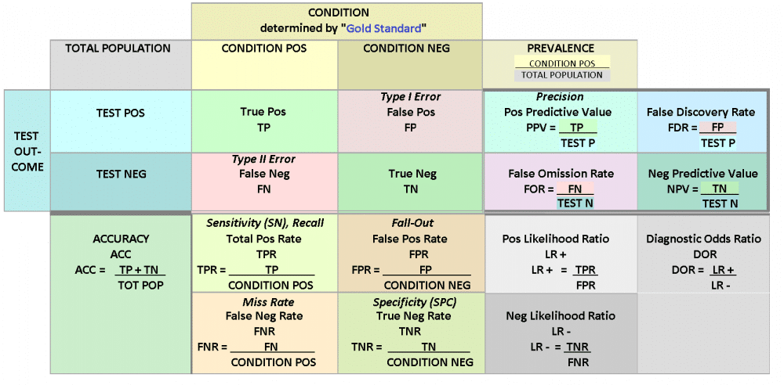

Slide 14
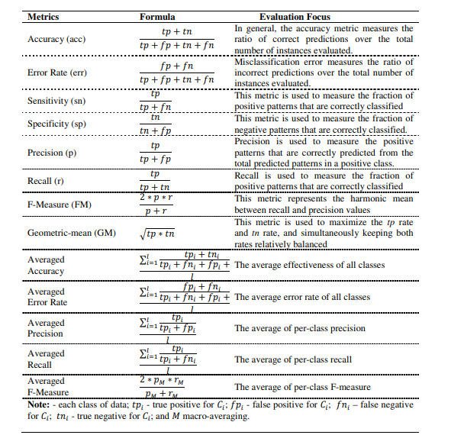

Slide 15
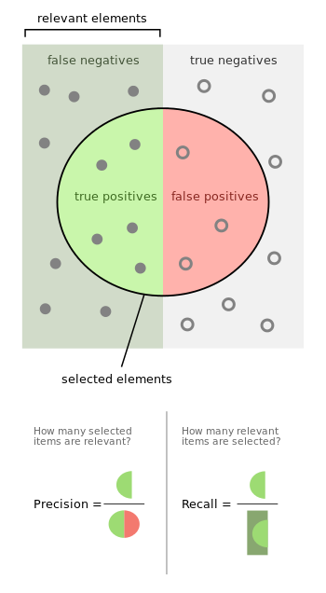

EVALUATION MATRICS
F1-SCORE
In statistical analysis of binary classification, the F1 score (also F-score or F-measure) is a measure of a test's accuracy. The traditional F-measure or balanced F-score (F1 score) is the harmonic mean of precision and recall:
F1: 2/ (recall⁻¹ + precision⁻¹)
F1: 2*(recall.precision)
(recall + precsion)

Slide 16
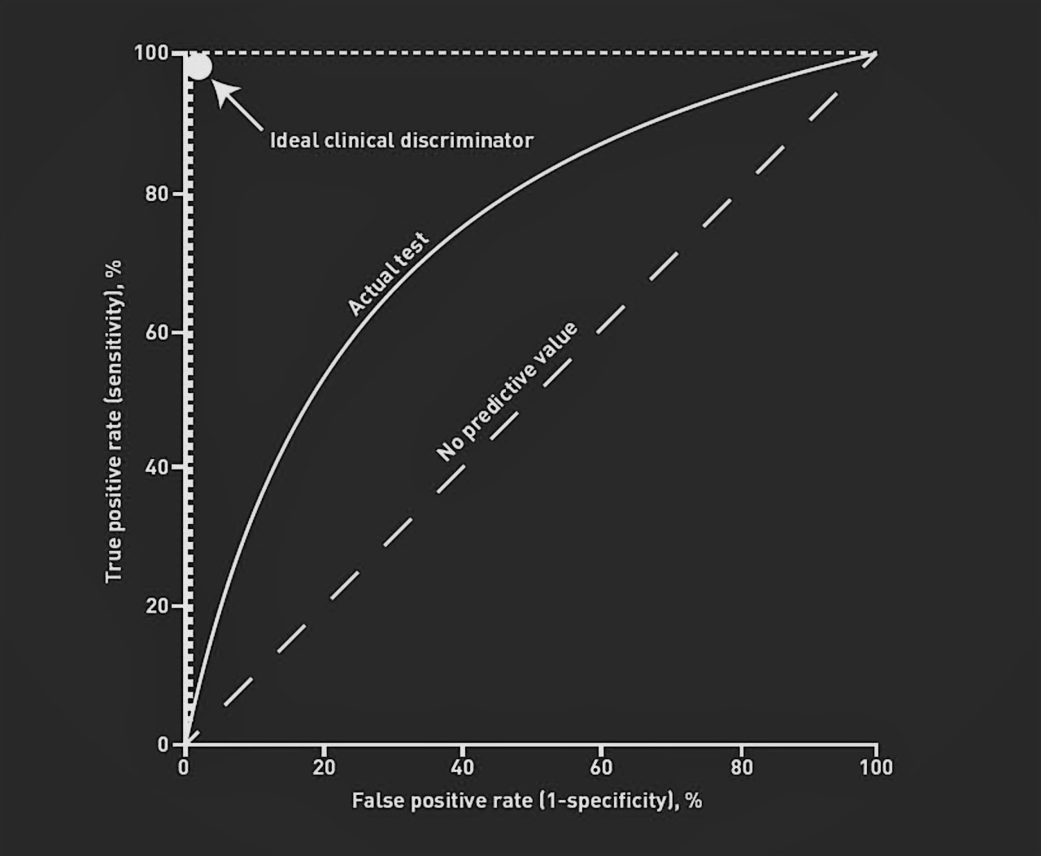
EVALUATION MATRICS
ROC CURVE
A useful tool when predicting the probability of a binary outcome is the Receiver Operating Characteristic curve, or ROC curve.
It is a plot of the false positive rate (x-axis) versus the true positive rate (y-axis) for a number of different candidate threshold values between 0.0 and 1.0.
The true positive rate is calculated as the number of true positives divided by the sum of the number of true positives and the number of false negatives. It describes how good the model is at predicting the positive class when the actual outcome is positive.

Slide 17
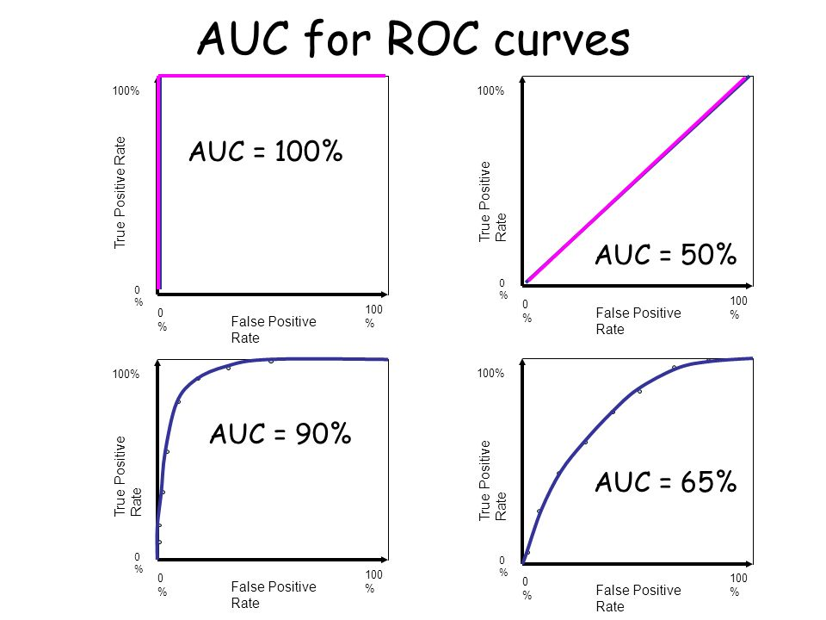
EVALUATION MATRICS
ROC CURVE FORMULAS
True Positive Rate = True Positives / (True Positives + False Negatives)
Sensitivity = True Positives / (True Positives + False Negatives)
False Positive Rate = False Positives / (False Positives + True Negatives)
False Positive Rate = False Positives / (False Positives + True Negatives)
False Positive Rate = 1 - Specificity

Slide 18
 | PRECISION | RECALL | F1-SCORE | SUPPORT | ACCURACY
SVM | 1.00 | 0.99 | 0.99 | 75 | 99.1228%
NAIVE BAYES | 0.59 | 0.66 | 0.62 | 67 | 90.3509%
DECISION TREE | 0.59 | 0.66 | 0.62 | 67 | 92.9825%
DT BAGGING | 0.59 | 0.66 | 0.62 | 67 | 92.9825%
EXTRA TREE | 0.59 | 0.66 | 0.62 | 67 | 92.9825%
RANDOM FOREST | 0.59 | 0.66 | 0.62 | 67 | 97.3684%
GRADIENT DESCENT | 0.59 | 0.66 | 0.62 | 67 | 97.3684%
XGBOOST | 0.97 | 0.99 | 0.98 | 75 | 97.3684%
ADABOOST | 0.97 | 1.00 | 0.99 | 75 | 98.2456%
ANN | 0.96 | 1.00 | 0.98 | 75 | 97.3684%
DEEP LEARNING | 0.96 | 1.00 | 0.98 | 75 | 97.3684%
CLASSFICIATION REPORT

Slide 19
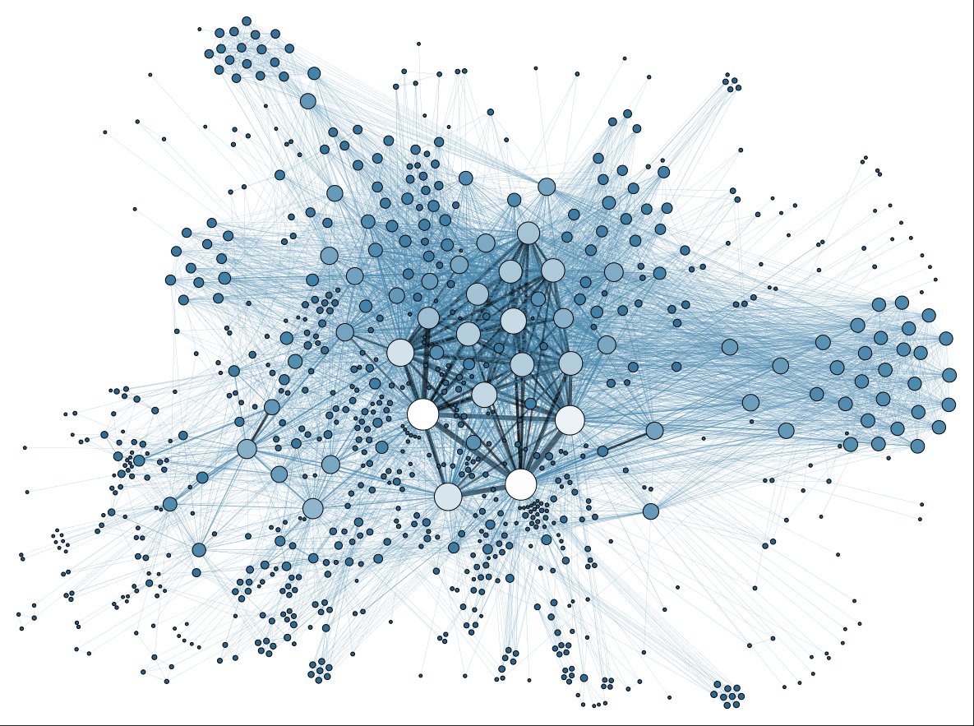
EVALUATION METRICS
OTHER EVALUATION METRICS
CLUSTERING
Rand Index
Mutual Information
Davies-Bouldin Index
Dunn Index
Silhouette Coefficient
OTHER
CV Error
Heuristic Methods to calculate 'k'
BLEU (NLP)

Slide 20
CONCLUSION
It is very important to use multiple evaluation metrics to evaluate your model. This is because a model may perform well using one measurement from one evaluation metric, but may perform poorly using another measurement from another evaluation metric. Using evaluation metrics are critical in ensuring that your model is operating correctly and optimally.
three

Slide 21
REFERENCES
[1]. N.V. Chawla, N. Japkowicz and A. Kolcz, “Editorial: Special issue on learning from imbalanced data
sets”, SIGKDD Explorations, 6 (2004) 1-6.
[2]. S. Garcia and F. Herrera, “Evolutionary training set selection to optimize C4.5 in imbalance
problems”, in Proc. of 8th Int. Conference on Hybrid Intelligent Systems (HIS 2008), Washington,
DC, USA, IEEE Computer Society, 2008, pp.567-572.
[3]. D. J. Hand and R. J. Till, “A simple generalization of the area under the ROC curve to multiple class
classification problems”, Machine Learning, 45 (2001) 171-186.
[4]. M. Hossin, M. N. Sulaiman, A. Mustapha, N. Mustapha and R. W. Rahmat, “A Hybrid Evaluation
Metric for Optimizing Classifier”, in Data Mining and Optimization (DMO), 2011 3rd Conference on,
2011, pp. 165-170.
[5]. J. Huang and C. X. Ling, “Using AUC and accuracy in evaluating learning algorithms”, IEEE
Transactions on Knowledge Data Engineering, 17 (2005) 299-310.
[6]. P. Lingras, and C. J. Butz, “Precision and recall in rough support vector machines”, in Proc. of the 2007 IEEE Int. Conference on Granular Computing (GRC 2007), Washington, DC, USA: IEEE Computer Society, 2007, pp.654-654.
[7]. D. J. C. MacKay, Information, Theory, Inference and Learning Algorithms. Cambridge, UK: Cambridge University Press, 2003.
[8]. F. Provost, and P. Domingos, “Tree induction for probability-based ranking”. Machine Learning, 52
(2003) 199-215.
[9]. A. Rakotomamonyj, “Optimizing area under ROC with SVMs”, in J. Hernandez-Orallo, C. Ferri, N. Lachiche and P. A. Flach (Eds.) 1st Int. Workshop on ROC Analysis in Artificial Intelligence (ROCAI 2004), Valencia, Spain, 2004, pp. 71-80.
[10]. R. Ranawana, and V. Palade, “Optimized precision-A new measure for classifier performance evaluation”, in Proc. of the IEEE World Congress on Evolutionary Computation (CEC 2006), 2006, pp. 2254-2261.
[11]. S. Rosset, “Model selection via AUC”, in C. E. Brodley (Ed.) Proc. of the 21st Int. Conference on Machine Learning (ICML 2004), New York, NY, USA: ACM, 2004, pp. 89. 9-108.
[12]. H. Wallach, “Evaluation metrics for hard classifiers”. Technical Report. (Ed.: Wallach, 2006)
http://www.inference.phy.cam.ac.uk/hmw26/papers
[13]. S. W. Wilson, “Mining oblique data with XCS”, in P. L. Lanzi, W. Stolzmann and S. W. Wilson (Eds.) Advances in Learning Classifier Systems: Third Int. Workshop (IWLCS 2000), Berlin, Heidelberg: Springer-Verlag, 2001, pp. 283-290.

Slide 22
Thank You For Watching
SEMINAR

